Slide 1


Slide 2
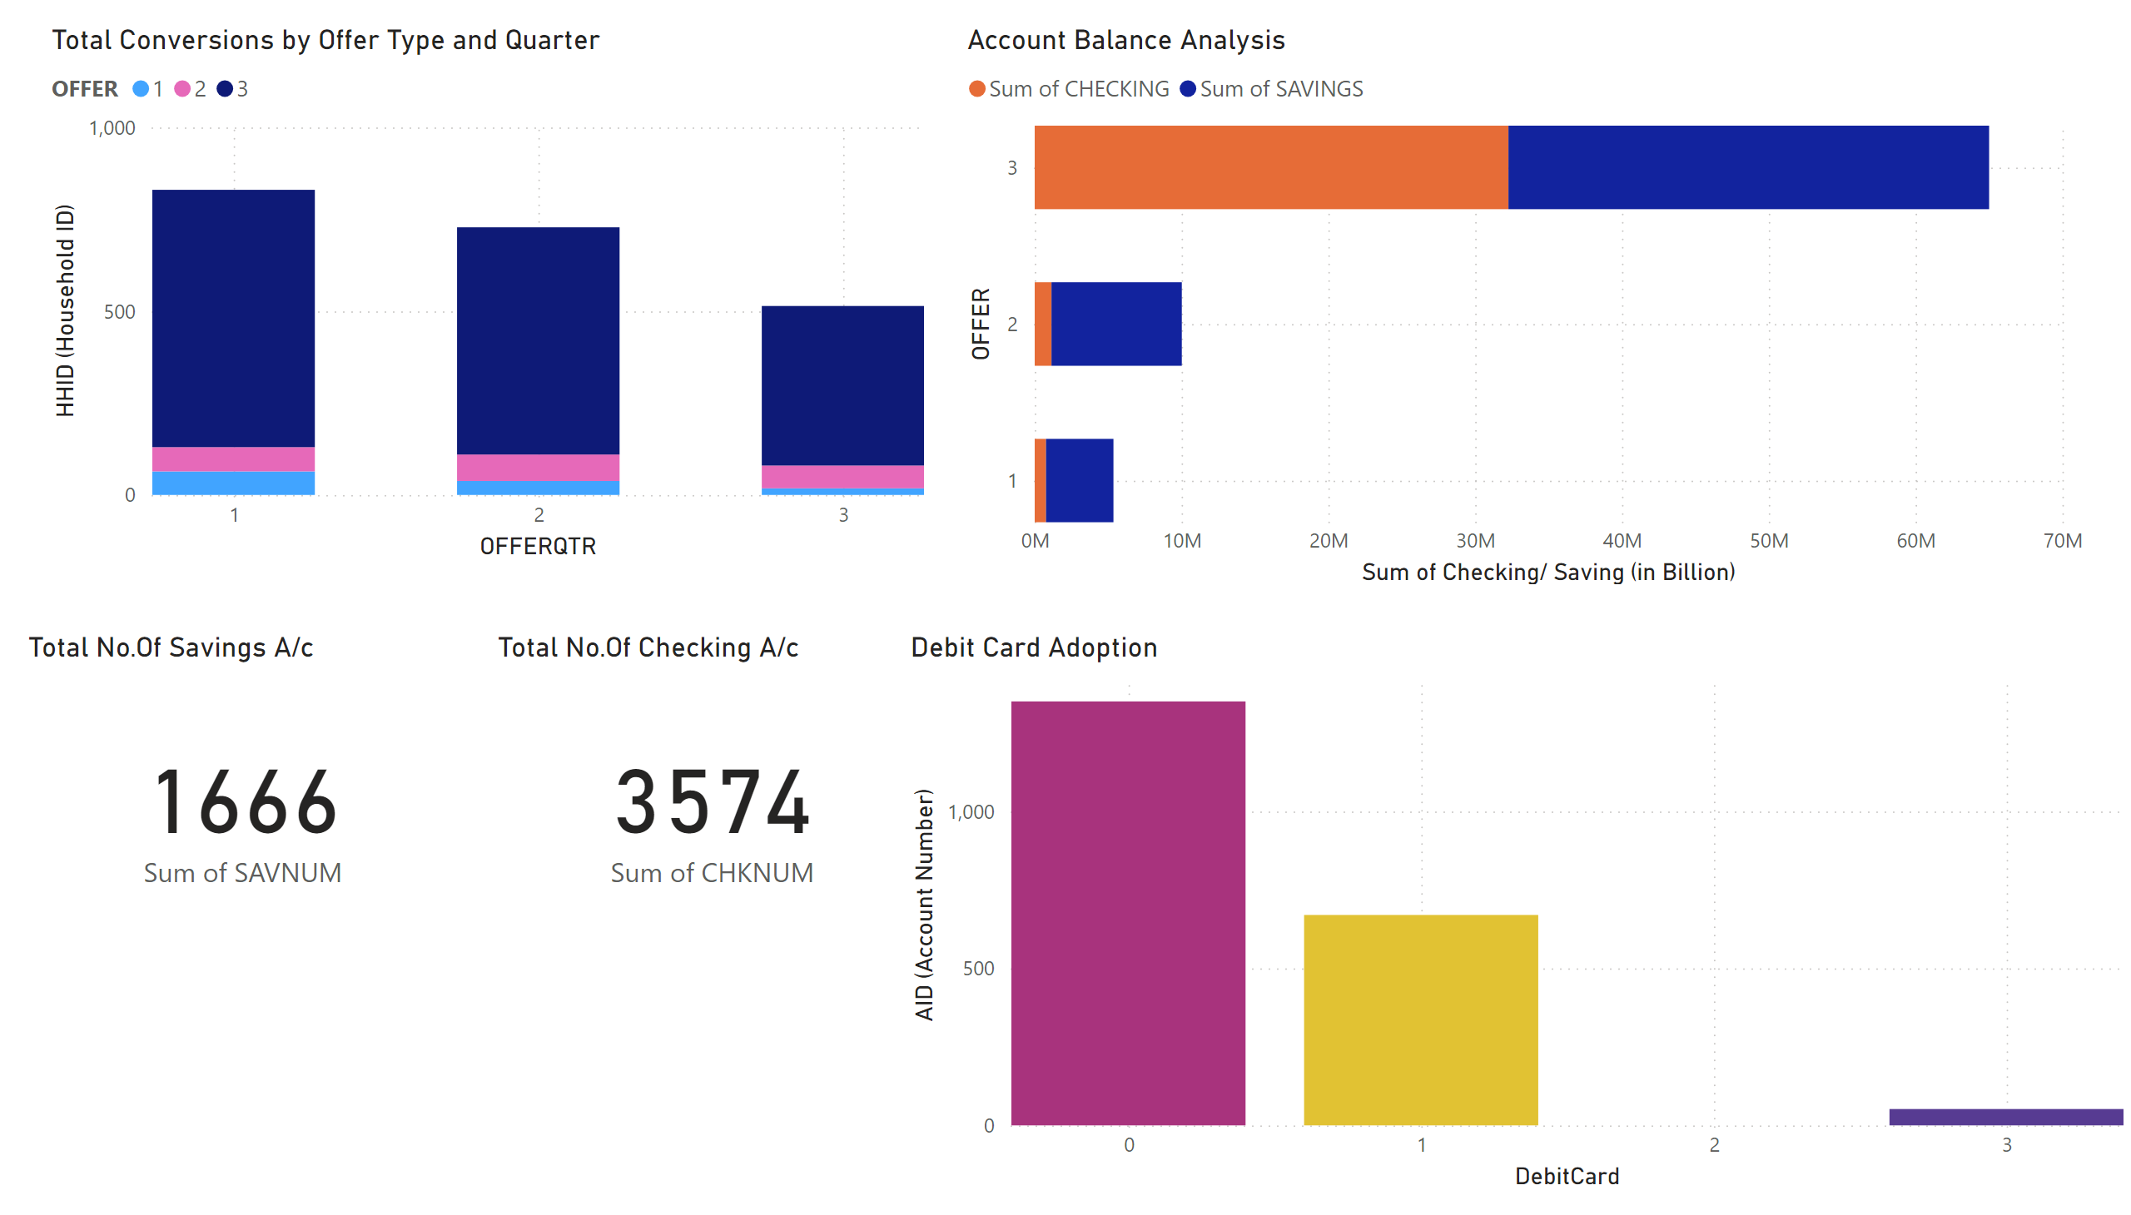
Campaign Performance Overview

Slide 3
Quarter | Offer Number | Campaign Cost | HHID Count | Household Reach | Conversion Rate | Cost Per Conversion
Q1 | Offer 1 | $1,673 | 64 | 202 | 31.68 | $26.14
Q2 | Offer 1 | $1,730 | 38 | 169 | 22.49 | $45.53
Q3 | Offer 1 | $1,527 | 18 | 110 | 16.36 | $84.83
 |  |  |  |  | 70.53
Q1 | Offer 2 | $1,673 | 66 | 328 | 20.12 | $25.35
Q2 | Offer 2 | $1,730 | 72 | 340 | 21.18 | $24.03
Q3 | Offer 2 | $1,527 | 62 | 325 | 19.08 | $24.63
 |  |  |  |  | 60.38
Q1 | Offer 3 | $1,673 | 700 | 2740 | 25.55 | $2.39
Q2 | Offer 3 | $1,730 | 618 | 2692 | 22.96 | $2.80
Q3 | Offer 3 | $1,527 | 434 | 2514 | 17.26 | $3.52
 |  |  |  |  | 65.77
Conversion Rate

Slide 4
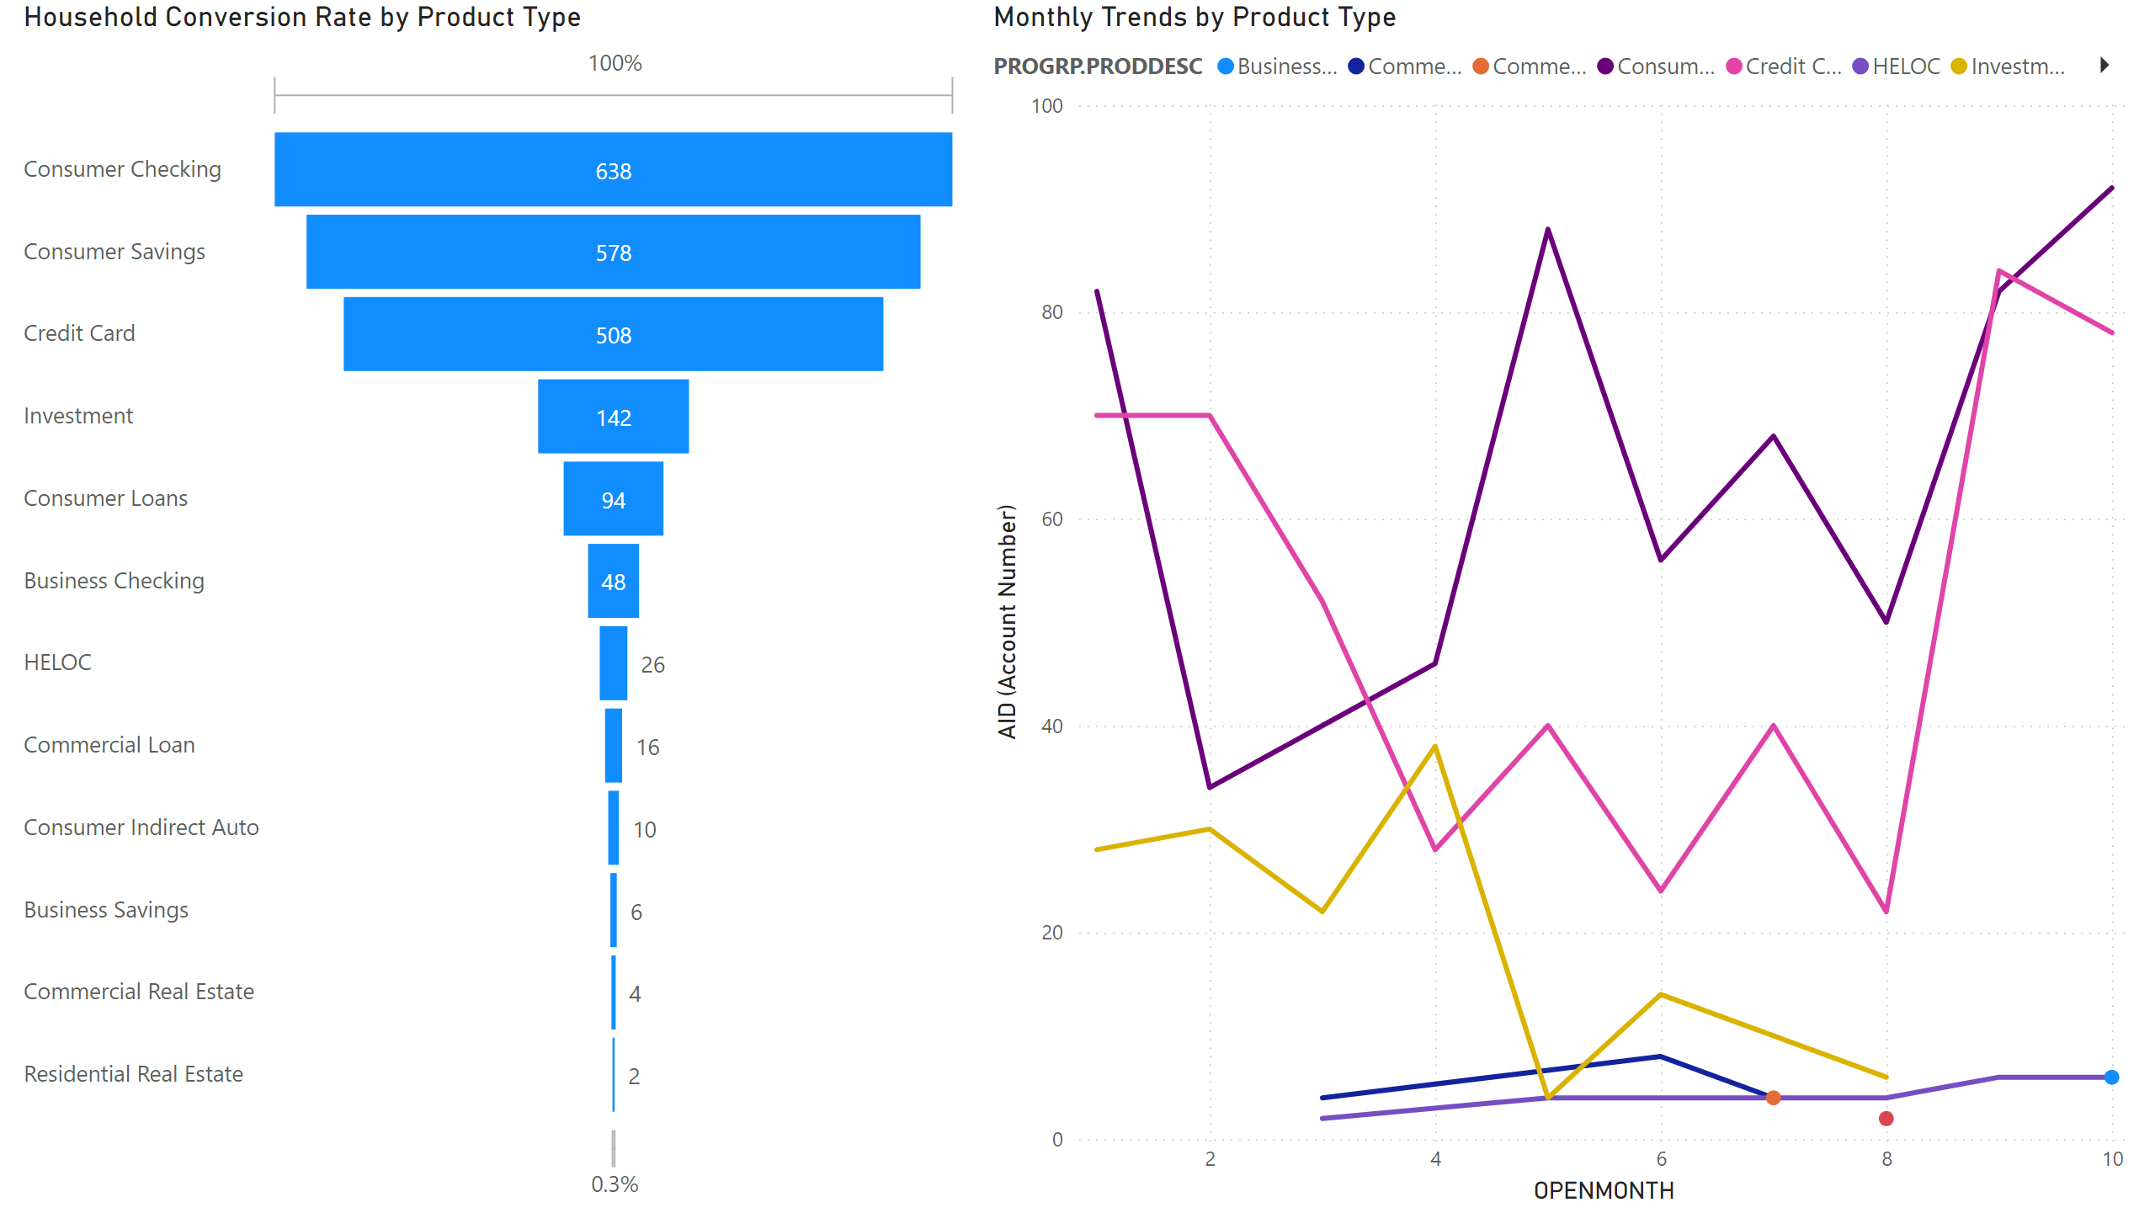
Product Engagement and Status

Slide 5
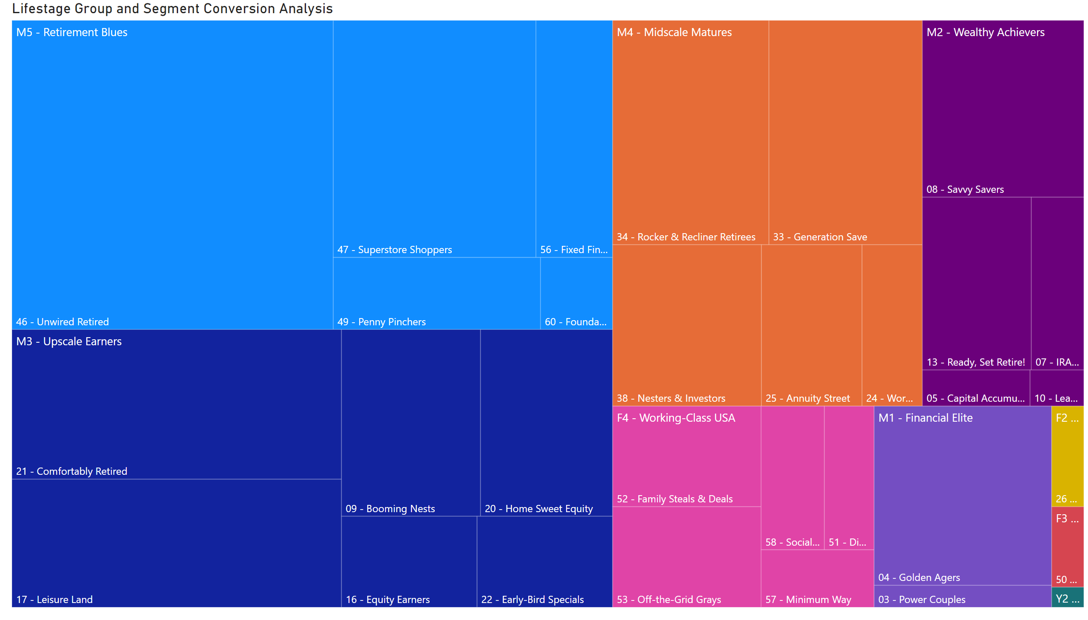
Household Profiles

Slide 6
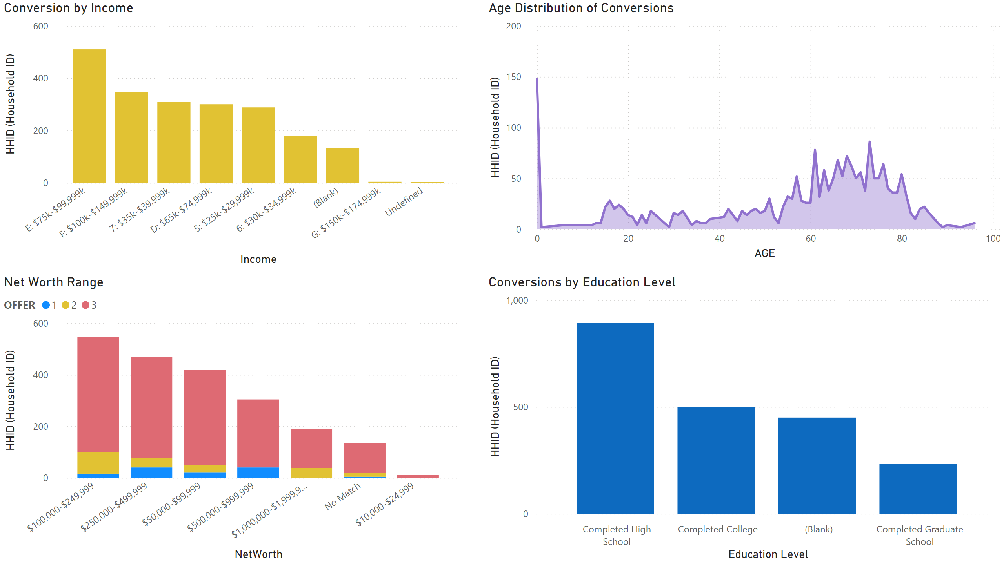
Demographic

Slide 7
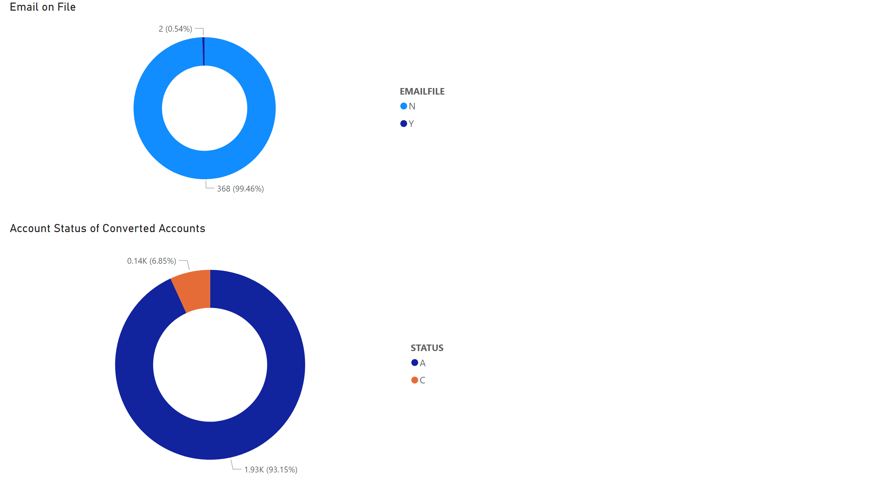
Q4 Forecast

Slide 8
Forecasting Q4
Quarter | Drop Date | Offer 1 | Offer 2 | Offer 3 | Cost
Q1 | 3/19/24 | 202 | 328 | 2,740 | $1,673
Q2 | 6/3/24 | 169 | 340 | 2,692 | $1,730
Q3 | 9/3/24 | 110 | 325 | 2,514 | $1,527
Q4 | 11/1/24 | 80 | 325 | 2,514 | $1,450

Slide 9

OFFER 4
Target Audience:
Segment: Client already having checking and savings account but not credit card
Demographic Focus: High net worth, More specifically, $75,000 - $99,999 income range; 40 to 50 and 60-70 age groups
Incentive:
Incentive: Referral bonuses for existing clients who bring in new clients Up to $100 in Bonuses.
Requirement 1: To earn $100 apply and get approved for a premium credit card.
Requirement 2: Spend at least $1000 within the first three months, and earn an additional $50.

Slide 10
Thank You

